Slide 1
Highway Planning & Design
Lecture - 4
Designed and presented
By
Asst. Prof. Dr. Raquim Nihad Zehawi

Slide 2
DESIGN OF THE ALIGNMENT
Vertical Alignment
The vertical alignment of a highway consists of straight sections known as grades, (or tangents) connected by vertical curves.
Vertical curves are used to provide a gradual change from one tangent grade to another so that vehicles may run smoothly as they traverse the highway.
These curves are usually parabolic in shape

Slide 3
DESIGN OF THE ALIGNMENT
The alignment of a highway is composed of vertical and horizontal elements
The vertical alignment includes straight (tangent) highway grades and the parabolic curves that connect these grades
The horizontal alignment includes the straight (tangent) sections of the roadway and the circular curves that connect their change in direction
The design of the alignment depends primarily on the design speed selected for the highway
It is important that both horizontal and vertical alignments be designed to complement each other, since this will result in a safer and more attractive highway

Slide 4
Vertical Alignment
The vertical alignment of a highway consists of straight sections known as grades, (or tangents) connected by vertical curves
The design of the vertical alignment involves the selection of suitable grades for the tangent sections and the appropriate length of vertical curves
Vertical curves are used to provide a gradual change from one tangent grade to another so that vehicles may run smoothly as they traverse the highway
These curves are usually parabolic in shape. The expressions developed for minimum lengths of vertical curves are therefore based on the properties of a parabola
1. Crest Vertical Curves.
Two types of Vertical Curves:
2. Sag Vertical Curves.

Slide 6
Vertical Curve Properties
• The initial road grade is called G1 the final road grade is called G2 and is typically given in percent.
• PVC is the point of the vertical curve.
• The point of intersection of the initial tangent grade and the final tangent grade is the point of vertical intersection (PVI).
• The absolute value of the difference between G1 and G2 is called A and is given in percent.
• The point of intersection of the vertical curve with the final tangent grade is called the PVT .
• The length (L) of the vertical curve is the horizontal distance between PVC and PVT.
• Equal Tangent, if PVC to PVI is L/2.

Slide 7
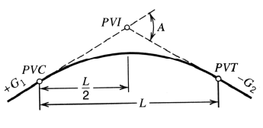


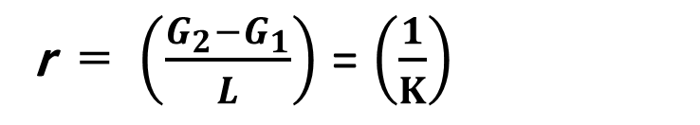

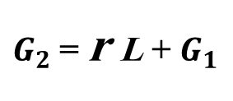
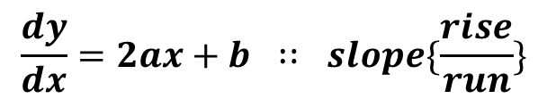


Vertical Curve Formula
$$y=ax^{2}+bx+c$$
assuming a constant rate of change of slope and equal tangent lengths.
When x = 0, y = C = elevation on curve = PVC elevation
$$\frac{dy}{dx}=2ax+b ∷ slope\{\frac{rise}{run}\}$$
at x = 0 => slope is $\frac{dy}{dx}=b=G_{1}$ (the initial slope)
d2y/dx2 = 2a = rate of change of slope termed (r)
$y_{x}=\left(\frac{G_{2}−G_{1}}{2L}\right)x^{2}+G_{1}x+Elevation at PVC$ Where: G2, G1(%), L (sta.), x (ft)
$2a=\left(\frac{G_{2}−G_{1}}{L}\right)$ $a=\left(\frac{G_{2}−G_{1}}{2L}\right)$
by integration dy /dx = r x + c = r x + $G_{1}$
$G_{2}$= r L + $G_{1}$
r = $\left(\frac{G_{2}−G_{1}}{L}\right)$ = $\left(\frac{1}{K}\right)$
at PVT x = L & slope = $G_{2}$

Slide 8
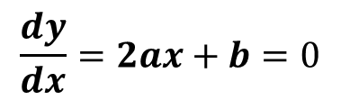


High / Low Point on Curve
If not PVC or PVT, (G1 and G2 have different signs)
$$\frac{dy}{dx}=2ax+b=0$$
b = G1
a = (G2 - G1) / 2L
then: the distance of the highest or lowest point on curve is $x_{hl}$
$x_{hl}$ = - G1L / (G2 - G1)
To find Elevation at the “turning” point Substitute “x” in:
$y_{x}=\left(\frac{G_{2}−G_{1}}{2L}\right)x^{2}+G_{1}x+Elevation at PVC$

Slide 9
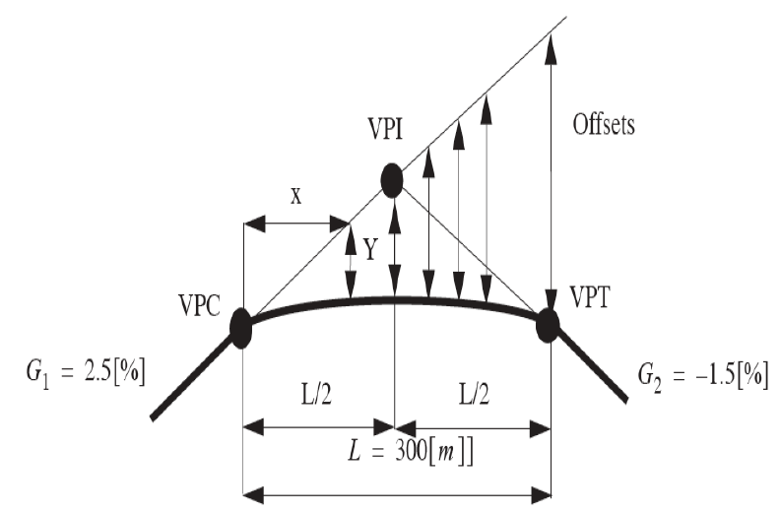

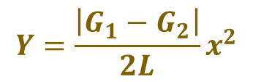
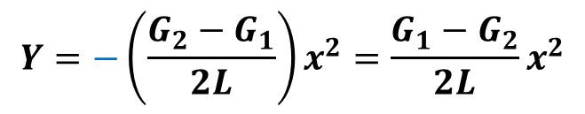
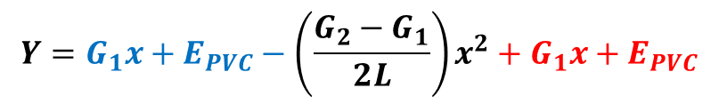
Concept of Offset
Offset Y of curve from initial grade line is very important parameter in vertical curve design
Y is defined as the offset at any distance, x, from the PVC.
Since
$y_{x}=\left(\frac{G_{2}−G_{1}}{2L}\right)x^{2}+G_{1}x+E_{PVC}$
Offset
$$Y=G_{1}x+E_{PVC}−\left(\frac{G_{2}−G_{1}}{2L}\right)x^{2}+G_{1}x+E_{PVC}$$
$$Y=−\left(\frac{G_{2}−G_{1}}{2L}\right)x^{2}=\frac{G_{1}−G_{2}}{2L}x^{2}$$
$$Y=\frac{\left|G_{1}−G_{2}\right|}{2L}x^{2}$$
The general formula for crest and sag curve

Slide 10

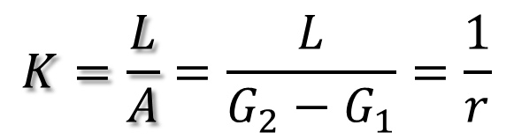
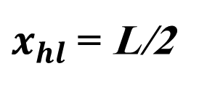
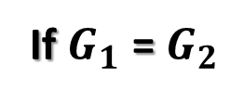
K : (rate of vertical curvature): is the horizontal distance in ft (meters) required to affect a 1% change in the slope of a vertical curve...
r : (rate of change in grade): is the change in the slope of a vertical curve in percent (%) in a horizontal distance unit ft (meters)...
It has several uses including simplifying the computation of the high/low points of vertical curves
K is calculated as follows
$$K=\frac{L}{A}=\frac{L}{G_{2}−G_{1}}=\frac{1}{r}$$
L is in ft (meters) , A is in percent.
The following equation is used to determine the horizontal distance to the high/low point in meters, given that the point does not occur at the PVC or PVT
If $G_{1}$ = $G_{2}$
$x_{hl}$= L/2
G1 is the absolute value of the initial grade in percent.
Watch the units. In equation , G1 was in m/m.

Slide 11
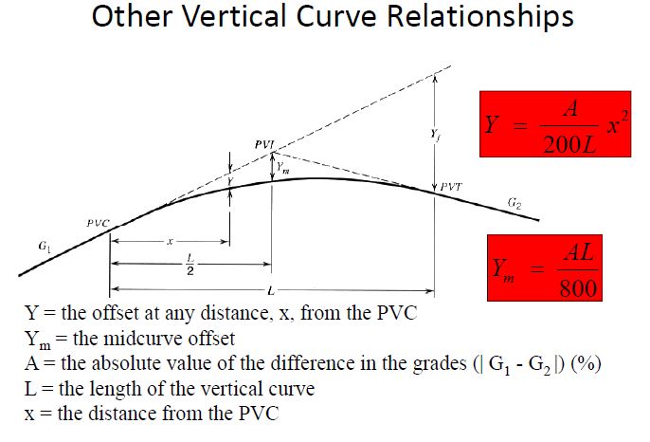
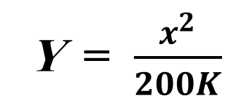
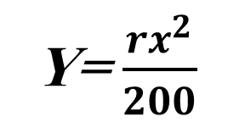
Y = $\frac{x^{2}}{200K}$
Y= $\frac{rx^{2}}{200}$

Slide 12
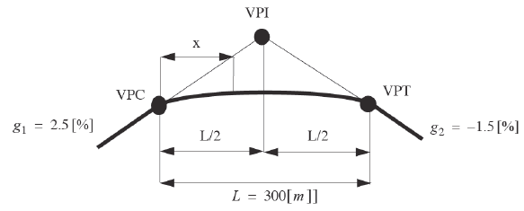
Example 1
The length of a tangent vertical curve equals 300 m.
The initial and final grades are G1= 2.5% & G2 = -1.5%
The grades intersect at the station 36 + 50 and at an elevation of 210.5 m
Determine the station and the elevation of the PVC & PVT
Calculate the elevation of the point on the
curve 100 m from the PVC
Determine the station and the elevation of the
highest point on the curve

Slide 13
Example 1 solution
1.1- To determine the stations of the PVC & PVT
PVC sta. = PVI sta. − L/2 = 36.50 + $\frac{1}{100}\frac{300}{2}$= 35.00
PVT sta. = PVC sta. + L = 35.00 + $\frac{1}{100}$ 300 = 38.00
1.2- To determine the elevations of the PVC & PVT
$E_{Pvc}=E_{PVI}−(G_{1}.\frac{L}{2})$ = 210.5 $−(0.025 × \frac{300}{2})$ = 210.5 – 3.75 = 206.75 m
$E_{PVT}=E_{PVI}−(G_{2}.\frac{L}{2})$ = 210.5 $−(0.015 × \frac{300}{2})$ = 210.5 – 2.25 = 208.25 m

Slide 14
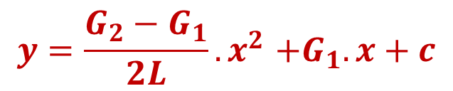

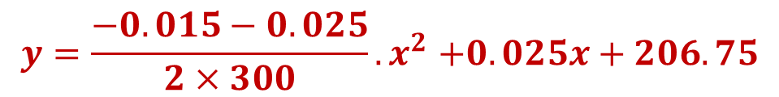
2- To determine the elevations of the point at 100 m distance from PVC:
$$y{=ax}^{2}+bx+c$$
$$y{=\frac{G_{2}−G_{1}}{2L}.x}^{2}+G_{1}.x+c$$
$$y{=\frac{−0.015−0.025}{2×300}.x}^{2}+0.025x+206.75$$
$$y{=−0.000067x}^{2}+0.025x+206.75$$
The elevation on the curve for the point at 100 m from PVC:
$$y{=−0.000067×100}^{2}+0.025×100+206.75=208.58 m$$

Slide 15

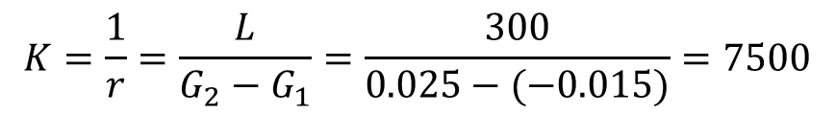
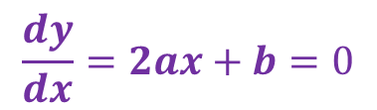
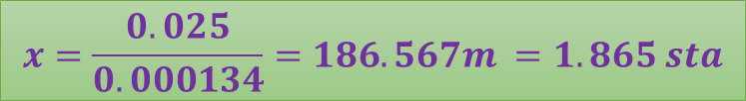
3- To determine the distance and elevation of the highest point on the curve:
A: The slope of the tangent at the highest point is zero
$$\frac{dy}{dx}=2ax+b=0$$
$$2×−0.000067x+0.025=0$$
$$x=\frac{0.025}{0.000134}=186.567m =1.865 sta$$
B: The distance of highest or lowest point from PVC =$X_{hl}=K. G_{1}$
$$K=\frac{1}{r}=\frac{L}{G_{2}−G_{1}}=\frac{300}{0.025−(−0.015)}=7500$$
$$X_{hl}=7500×0.025=187.5 m=1.875 sta$$
Since
$$y{=−0.000067x}^{2}+0.025x+206.75$$
$$y_{h}{=−0.000067×(187.5)}^{2}+0.025×187.5+206.75=209.082$$
$$y_{h}{=−0.000067×(186.5)}^{2}+0.025×186.5+206.75=209.082$$

Slide 16
Example 3.1: HW.
A 600ft equal tangent sag vertical curve has the PVC at station 170 +00 and elevation 1000ft. The initial grade is -3.5 % and the final grade is 0.5 %.
Determine the elevation and stationing of the PVI, PVT, and the lowest point on the curve.

